Slide 1

Infants make more attempts to achieve a goal when they see adults persist
by Julia A. Leonard, Yuna Lee, and Laura E. Schulz
Science
Volume 357(6357):1290-1294
September 22, 2017
Published by AAAS

Slide 2
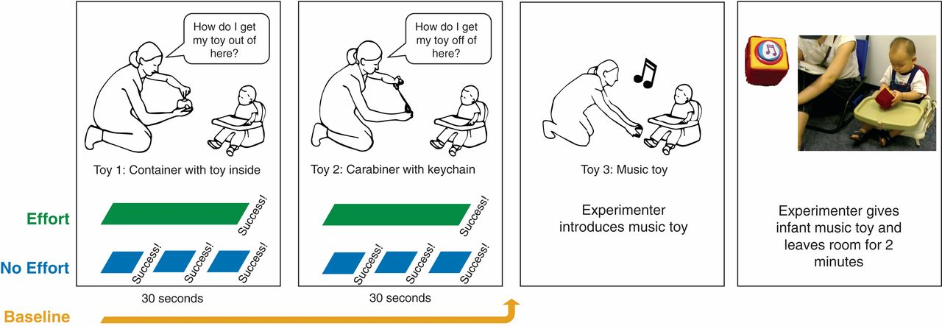
Fig. 1 Schematic of study design.
Julia A. Leonard et al. Science 2017;357:1290-1294
Published by AAAS
Notes:
Schematic of study design. In experiment 1, infants were assigned to one of three conditions: Effort, No Effort, or Baseline. In the Effort condition, the experimenter struggled for 30 s before achieving each of two goals. In the No Effort condition, the experimenter achieved her goals effortlessly three times over 30 s. In the Baseline condition, there was no experimenter demonstration. The experimenter then introduced the infant to a novel toy, activated the toy out of the infant’s sight so that it played a tune for 5 s, gave the infant the toy, and left the room for 2 min. The dependent variables were the number of times that infants pressed the large (inert) button on the music toy in total and before the first handoff.

Slide 3
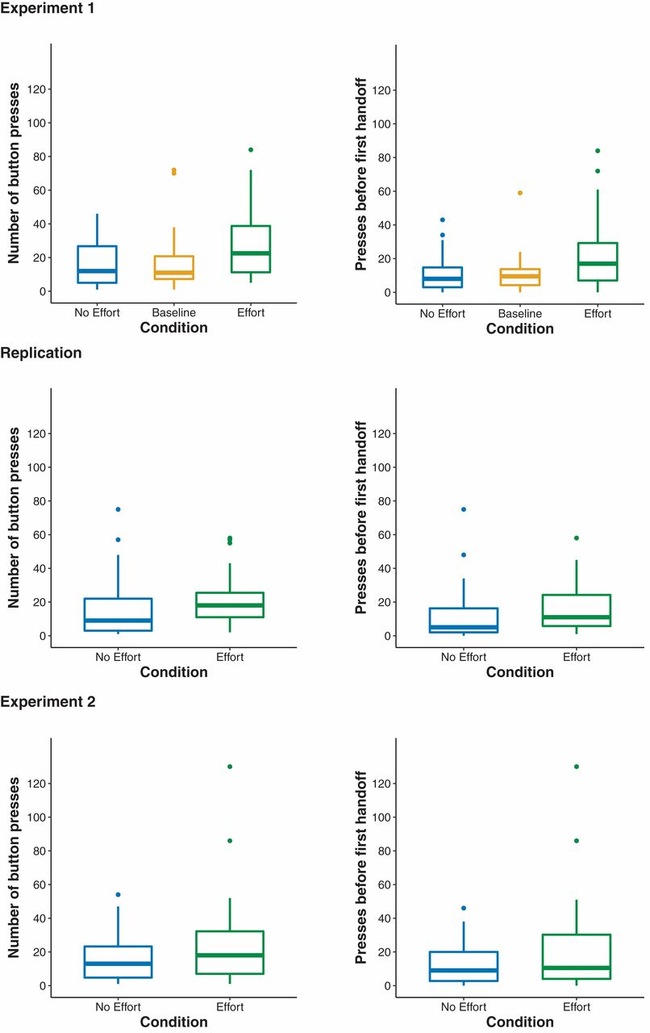
Fig. 2 Results from experiment 1, the replication, and experiment 2.
Julia A. Leonard et al. Science 2017;357:1290-1294
Published by AAAS
Notes:
Results from experiment 1, the replication, and experiment 2. The top and the bottom of the box correspond to the first and third quartiles (the 25th and 75th percentiles). The upper whisker (vertical line) extends from the third quartile to the largest value no further than 1.5 interquartile ranges from the third quartile; the lower whisker extends from the 25th percentile down to the smallest value no further than 1.5 interquartile ranges from the first quartile (i.e., the largest and smallest values that are not outliers). The dots are values more than 1.5 times the interquartile range above the third quartile (outliers). See text for statistical analyses.

